Slide 1
PANDAS
Pandas is an open-source library that is made mainly for working with relational or labeled data both easily and intuitively. It provides various data structures and operations for manipulating numerical data and time series. This library is built on the top of the NumPy library. Pandas is fast and it has high-performance & productivity for users.

Slide 2
PANDAS
Pandas is an open-source Python Library providing high-performance data manipulation and analysis tool using its powerful data structures. The name Pandas is derived from the word Panel Data – an Econometrics from Multidimensional data.
In 2008, developer Wes McKinney started developing pandas when in need of high performance, flexible tool for analysis of data.
Prior to Pandas, Python was majorly used for data munging and preparation. It had very little contribution towards data analysis. Pandas solved this problem. Using Pandas, we can accomplish five typical steps in the processing and analysis of data, regardless of the origin of data — load, prepare, manipulate, model, and analyze.
Python with Pandas is used in a wide range of fields including academic and commercial domains including finance, economics, Statistics, analytics, etc.

Slide 3
History
Pandas was initially developed by Wes McKinney in 2008 while he was working at AQR Capital Management. He convinced the AQR to allow him to open source the Pandas. Another AQR employee, Chang She, joined as the second major contributor to the library in 2012. Over the time many versions of pandas have been released. The latest version of the pandas is 1.0.1

Slide 4
IMPORTING LIBRARY
After the pandas has been installed into the system, you need to import the library. This module is generally imported as
import pandas as pd
Here, pd is referred to as an alias to the Pandas. However, it is not necessary to import the library using alias, it just helps in writing less amount of code everytime a method or property is called.

Slide 5
Data structures
Pandas deals with the following three data structures −
Series
DataFrame
Panel
Data Structure | Dimensions | Description
Series | 1 | 1D labeled homogeneous array, sizeimmutable.
Data Frames | 2 | General 2D labeled, size-mutable tabular structure with potentially heterogeneously typed columns.
Panel | 3 | General 3D labeled, size-mutable array.

Slide 6
Series
Series is a one-dimensional array like structure with homogeneous data. For example, the following series is a collection of integers 10, 23, 56, …
Homogeneous data
Size Immutable
Values of Data Mutable

Slide 7
Data frame
DataFrame is a two-dimensional array with heterogeneous data. For example,
Name | Age | Gender | Rating
Steve | 32 | Male | 3.45
Lia | 28 | Female | 4.6
Vin | 45 | Male | 3.9
Katie | 38 | Female | 2.78
The table represents the data of a sales team of an organization with their overall performance rating. The data is represented in rows and columns. Each column represents an attribute and each row represents a person.
Heterogeneous data, Size Mutable, Data Mutable

Slide 8
Panel
Panel is a three-dimensional data structure with heterogeneous data. It is hard to represent the panel in graphical representation. But a panel can be illustrated as a container of DataFrame.
Key Points
Heterogeneous data
Size Mutable
Data Mutable

Slide 9
Series-constructor
Series is a one-dimensional labeled array capable of holding data of any type (integer, string, float, python objects, etc.). The axis labels are collectively called index.
A pandas Series can be created using the following constructor −
pandas.Series( data, index, dtype, copy)

Slide 10
Series-constructor options
Sr.No | Parameter & Description
1 | data data takes various forms like ndarray, list, constants
2 | index Index values must be unique and hashable, same length as data. Default np.arrange(n) if no index is passed.
3 | dtype dtype is for data type. If None, data type will be inferred
4 | copy Copy data. Default False
A series can be created using various inputs like −
Array
Dict
Scalar value or constant

Slide 11
# Program to create series
# Import Panda Library
import pandas as pd
# Create series with Data, and Index
a = pd.Series(Data, index = Index)
# Program to Create series with scalar values
# Numeric data
Data =[1, 3, 4, 5, 6, 2, 9]
# Creating series with default index values
s = pd.Series(Data)
# predefined index values
Index =['a', 'b', 'c', 'd', 'e', 'f', 'g']
# Creating series with predefined index values
si = pd.Series(Data, Index)

Slide 12
# Program to Create Dictionary series
dictionary ={'a':1, 'b':2, 'c':3, 'd':4, 'e':5}
# Creating series of Dictionary type
sd = pd.Series(dictionary)
# Program to Create ndarray series
# Defining 2darray
Data =[[2, 3, 4], [5, 6, 7]]
# Creating series of 2darray
snd = pd.Series(Data)

Slide 13
Exercise
Create an Empty Series
Create a Series from ndarray
Create a Series from dict
Create a Series from Scalar
Accessing Data from Series with Position
Retrieve Data Using Label (Index)

Slide 14
Data frame
A Data frame is a two-dimensional data structure, i.e., data is aligned in a tabular fashion in rows and columns.
Features of DataFrame
Potentially columns are of different types
Size – Mutable
Labeled axes (rows and columns)
Can Perform Arithmetic operations on rows and columns

Slide 15
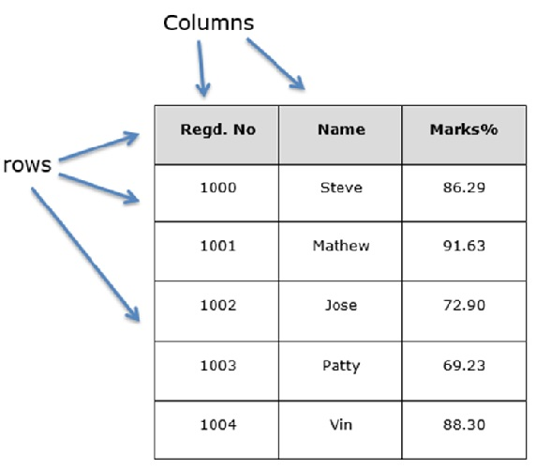
Data frame- structure

Slide 16
DataFrame-constructor
A pandas DataFrame can be created using the following constructor −
pandas.DataFrame( data, index, columns, dtype, copy)

Slide 17
Data frame-constructor options
Sr.No | Parameter & Description
1 | data data takes various forms like ndarray, series, map, lists, dict, constants and also another DataFrame.
2 | index For the row labels, the Index to be used for the resulting frame is Optional Default np.arange(n) if no index is passed.
3 | columns For column labels, the optional default syntax is - np.arange(n). This is only true if no index is passed.
4 | dtype Data type of each column.
5 | copy This command (or whatever it is) is used for copying of data, if the default is False.

Slide 18
Create DataFrame
A pandas DataFrame can be created using various inputs like −
Lists
dict
Series
Numpy ndarrays
Another DataFrame

Slide 19
# Program to Create DataFrame
# Import Library
import pandas as pd
# Create DataFrame with Data
a = pd.DataFrame(Data)
# Program to Create Data Frame with two dictionaries
# Define Dictionary 1
dict1 ={'a':1, 'b':2, 'c':3, 'd':4}
# Define Dictionary 2
dict2 ={'a':5, 'b':6, 'c':7, 'd':8, 'e':9}
# Define Data with dict1 and dict2
Data = {'first':dict1, 'second':dict2}
# Create DataFrame
df = pd.DataFrame(Data)

Slide 20
# Program to create Dataframe of three series
import pandas as pd
# Define series 1
s1 = pd.Series([1, 3, 4, 5, 6, 2, 9])
# Define series 2
s2 = pd.Series([1.1, 3.5, 4.7, 5.8, 2.9, 9.3])
# Define series 3
s3 = pd.Series(['a', 'b', 'c', 'd', 'e'])
# Define Data
Data ={'first':s1, 'second':s2, 'third':s3}
# Create DataFrame
dfseries = pd.DataFrame(Data)
# Program to create DataFrame from 2D array
# Import Library
import pandas as pd
# Define 2d array 1
d1 =[[2, 3, 4], [5, 6, 7]]
# Define 2d array 2
d2 =[[2, 4, 8], [1, 3, 9]]
# Define Data
Data ={'first': d1, 'second': d2}
# Create DataFrame
df2d = pd.DataFrame(Data)

Slide 21
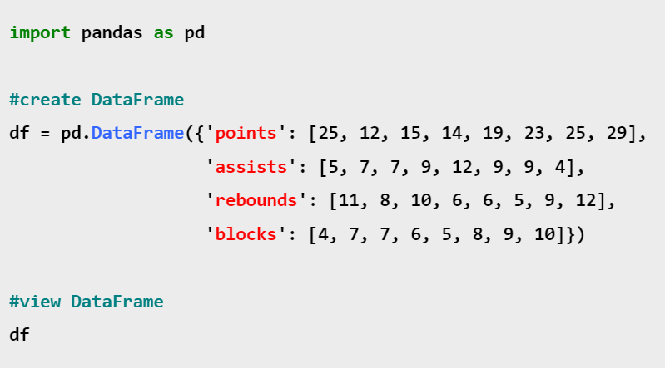
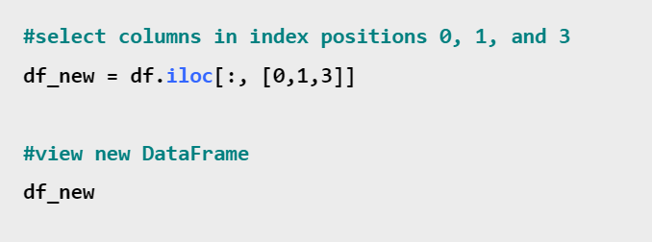

Slide 22
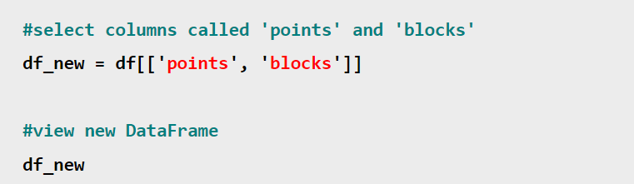
Row selection
df.iloc[[4],:]
df.iloc[[2, 3, 4]]
df.iloc[2:5]

Slide 23
Exercise
Create an Empty DataFrame
Create a DataFrame from Lists
Create a DataFrame from Dict of ndarrays / Lists
Create a DataFrame from List of Dicts
Create a DataFrame from Dict of Series
Column Selection
Column Addition
Column deletion
Row Selection
Row Addition
Row Deletion
Slice Rows

Slide 24
Reading CSV Files using Pandas
read_csv is an important pandas function to read csv files and do operations on it.

Slide 25
Reading csv files
import pandas as pd file = 'highscore.csv' df = pd.read_csv(file)
df = pd.read_csv('file_name.csv', usecols= ['column_name1','column_name2'])
df= pd.read_csv('file_name.csv',usecols=[1,2,3])
# Only reads col1, col2, col3. col0 will be ignored
df= pd.read_csv('file_name.csv',usecols=['Name'])
# Only reads 'Name' column. Other columns will be ignored. print(df)

